Slide 1
OpenCity Hackathon
Tree Canopy Cover
Srivalli
Ayush
Karthik
Pratham
Shout out to Ganesh (WRI)

Slide 2
Problem Statement
Area of tree canopy cover – Annual change in Bengaluru’s tree canopy cover (‘Tree canopy cover’ refers to the layer of leaves, branches, and stems of trees that, when viewed from above, covers the ground)

Slide 3
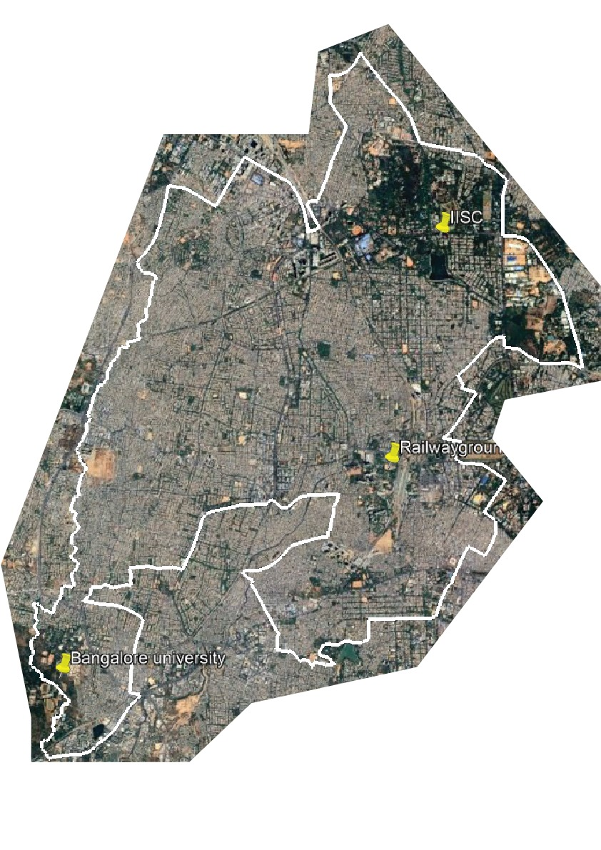
Area of Interest

Slide 4
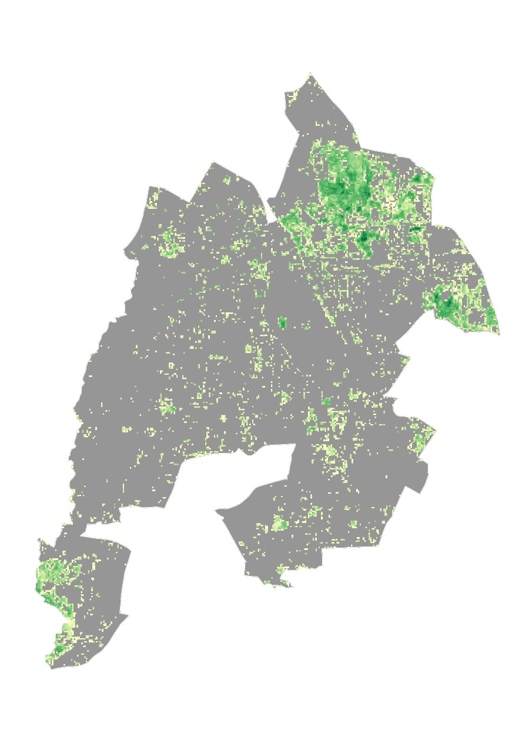
Direct Measure: Global Forest Canopy Height from GEDI & Landsat (>=1m)
2019

Slide 5
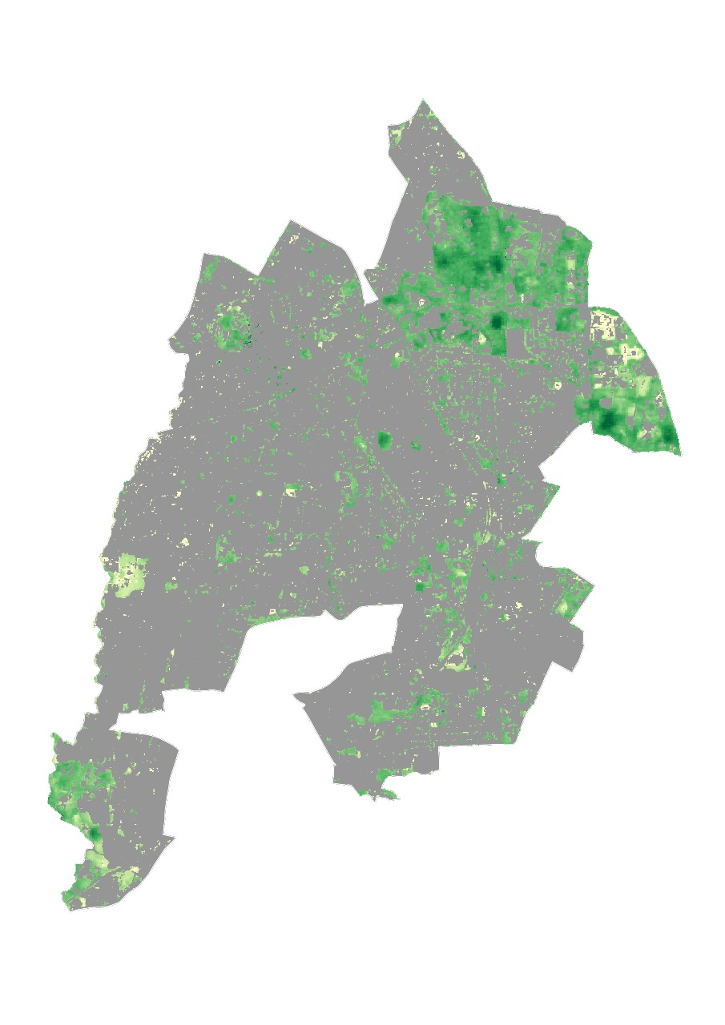
Direct Measure: Global Forest Canopy Height from GEDI & Landsat (>=1m)
2020

Slide 6
Direct Measure: Global Forest Canopy Height from GEDI & Landsat Area of Tree Cover (count of pixels with value >=1m)
2019
30m, April-Oct
10 sqkm
2020
10m, entire year
11 sqkm

Slide 7
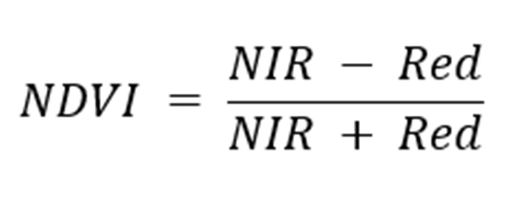
Approximate Measure: LANDSAT NDVI 2013-2025

Slide 8
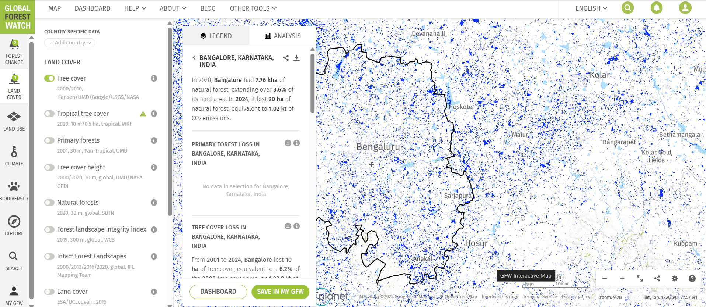
Global Forest Watch Dashboard

Slide 9
Architecture Checklist
Google Earth Engine API
QGIS
Python
Streamlit
GCP/Azure/AWS for Hosting

